Slide 1
The chat app
Bits f463, blockchain project
By,
Saumya Shikhar Mishra Shivang Singh Raj Agarwal Kshitij Ingle Gaurang Gupta

Slide 2
What the app does.
Broadly and plainly, the application allows two users on the same network to chat with each other, all one needs to know is the other person’s IP Address. The user can either be a simple user, or a miner. Every miner is a user. Whenever a message is sent to the receiver, it is first encrypted using the receiver’s public key and then broadcasted across the network, i.e. everyone on the network would receive this message, including the miner. But note that only the intended user would be able to decode it.
As soon as a miner gets a message (which would be encrypted), he would mine the corresponding block and broadcast it to everyone. All the users on the network would receive this block, match whether it’s previous hash is same as the last block on the blockchain’s current hash, and if it is, they would add it. Hence, even if there are multiple miners, only a single block would be added because as soon as a block is added, the last hash gets updated.
Finally, users can view their received messages from the blockchain. Note that they would not be able to see other user’s messages as they would need their private key to decode it.

Slide 3
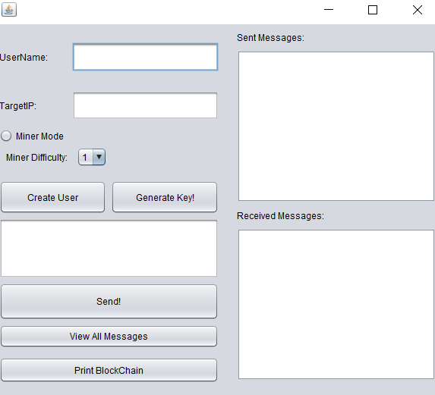
What the app is.
The app is developed on Java, through Swing GUI.
R.S.A Algorithm has been used for Key generation, Encryption and Decryption.
To transfer messages over network, we use User Datagram Protocol (UDP) instead of TCP/IP, as that would require having a server, which is very much against what we intend to do. We wanted a Server-less platform and it is for this reason we sought out to use the blockchain.
The app demonstrates the use of concepts like Public Key Cryptography, Modular Arithmetic, Hash Functions, and Distributed Ledgers in a decentralized environment.

Slide 4
Classes
There are total 9 classes we made and used:
Message: Holds the receiver, sender, encrypted message and a constant string “VERIFY” to verify transaction (discussed later).
User: Every user has two attributes public key (an object of class PublicKey) and a username and his/her IP Address.
MyUser extends User: The current user. Has attributes for sockets and datagrams, a private key (an object of class Private Key), an object otherUser of class User and a linked list of Blocks (see 5).
Miner extends MyUser. : Every miner is a user. Overrides the send and receive methods of MyUser to mine and broadcast blocks.
Block: Building blocks of a blockchain. For simplicity the number of transactions per block is limited to 1.
StringUtil – Used for implementing SHA256 i,e. Hash functions.
TheChatApp – Implements the GUI interface for the user.
ChatArea – Keeps track of the live chat between the users.
SerializeObjects – Used to convert a string to a byte stream and vice-versa, facilitating transfer over the network.

Slide 5
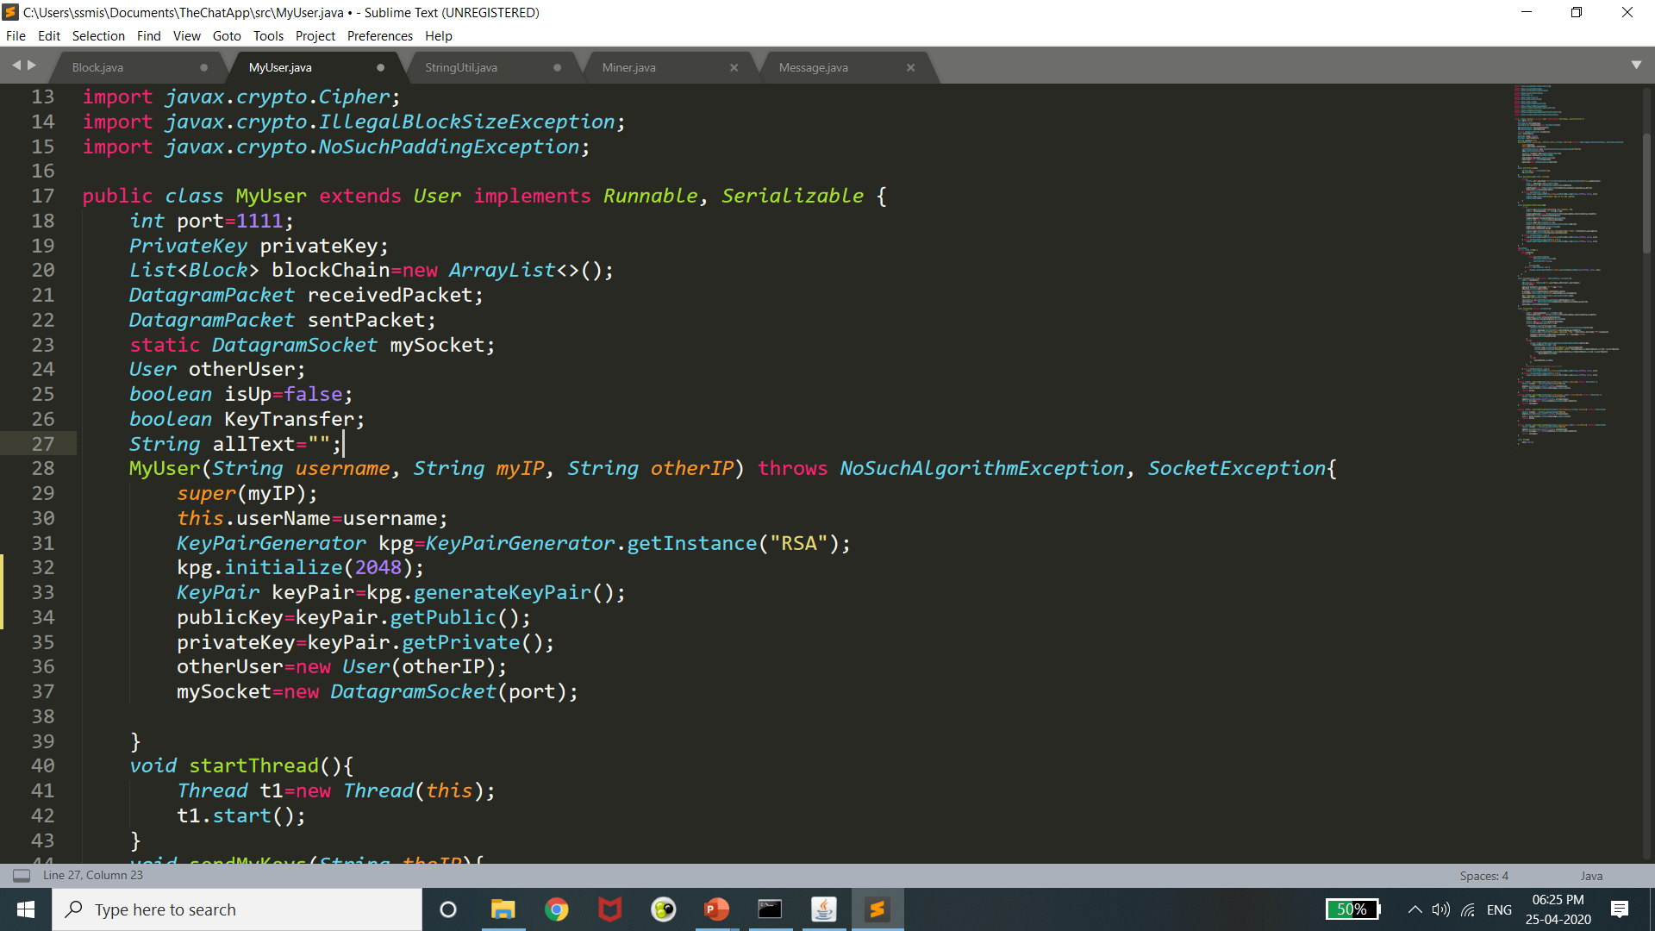
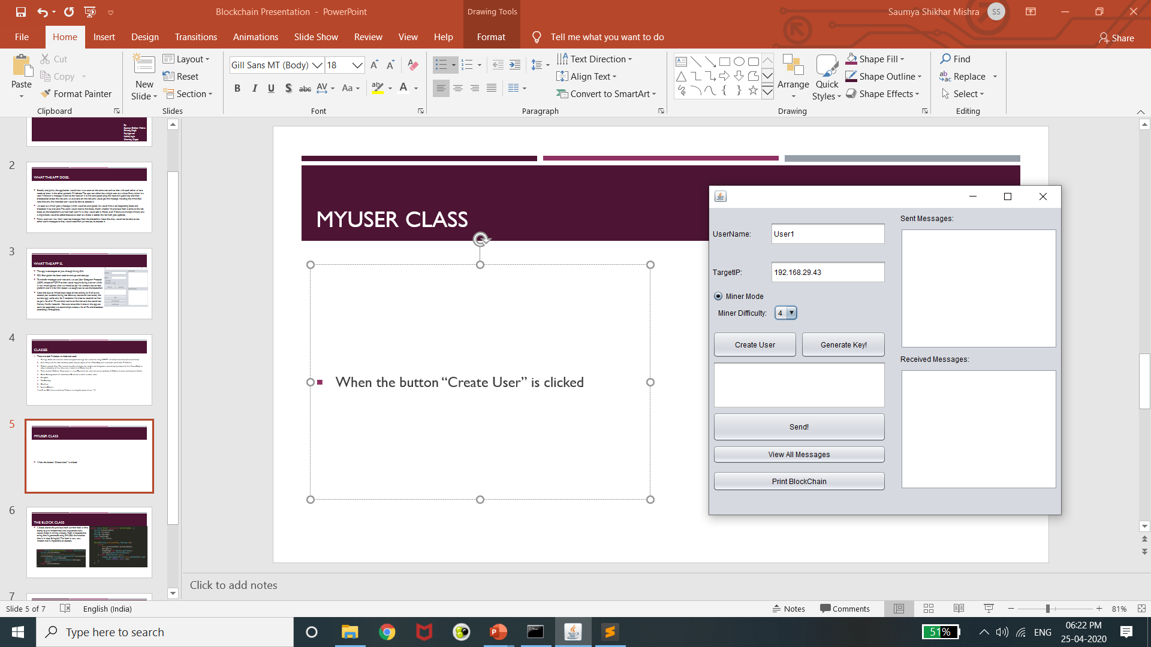
Myuser class
When the button “Create User” is clicked, an object of “MyUser” type is created. Sockets objects are created, an object “otherUser” is initialized with target IP address and a new blockchain is initiated. His RSA private key and public key are also generated.

Slide 6
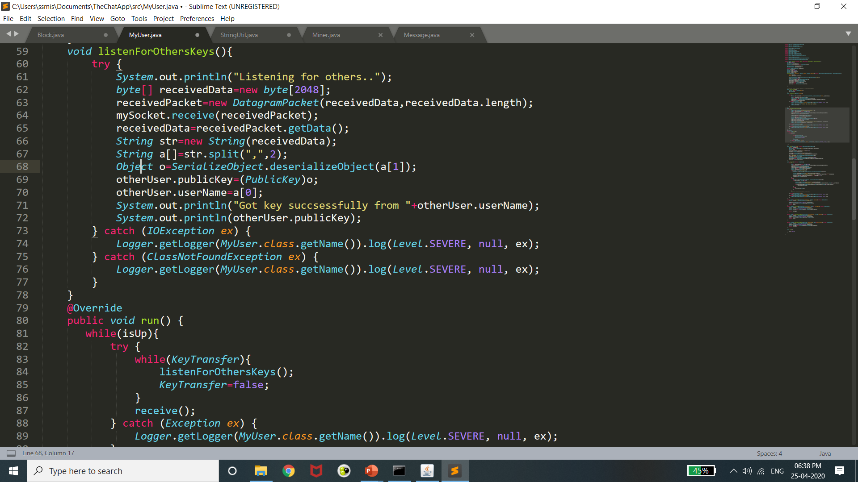

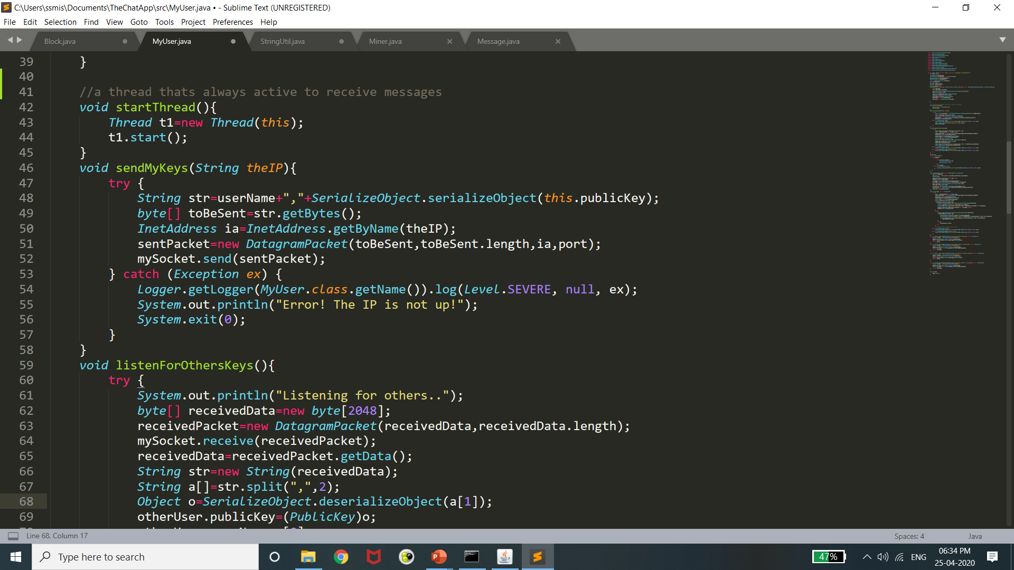
Myuser class
On clicking the Generate Keys button, the current user starts a new thread (t1) and sends his PUBLIC key and name to the other user, and receives the same. This new thread would always be up and running to receive messages.

Slide 7
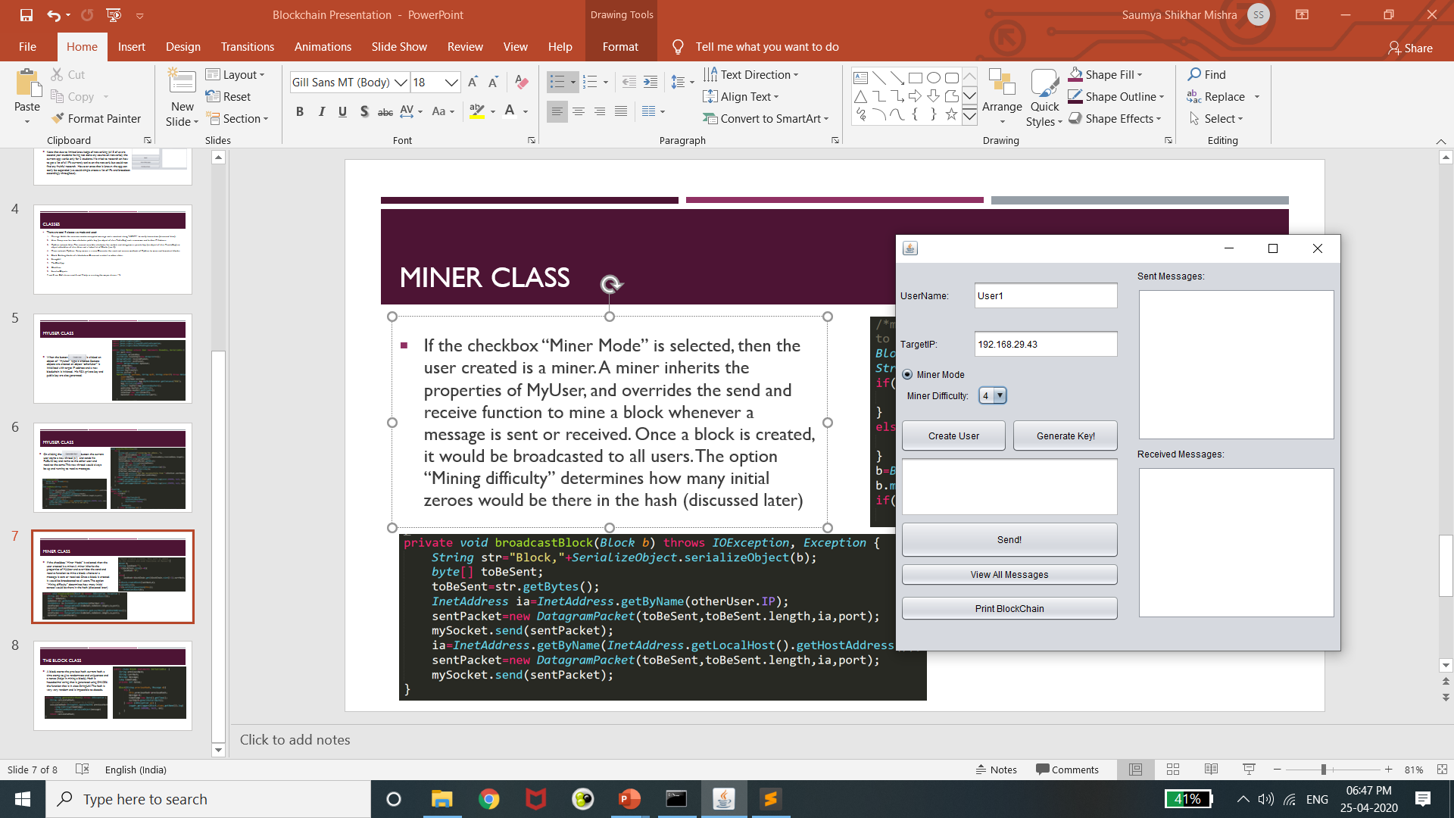
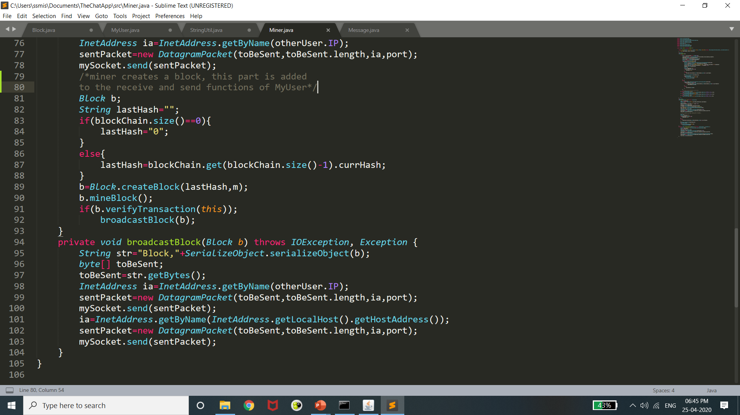
Miner class
If the checkbox Miner Mode is selected, then the user created is a miner. A miner inherits the properties of MyUser, and overrides the send and receive functions of MyUser to mine a block whenever a message is sent or received. Once a block is created, it would be broadcasted to all the users. The option “Mining difficulty” determines how many initial zeroes would be there in the hash (discussed later)

Slide 8
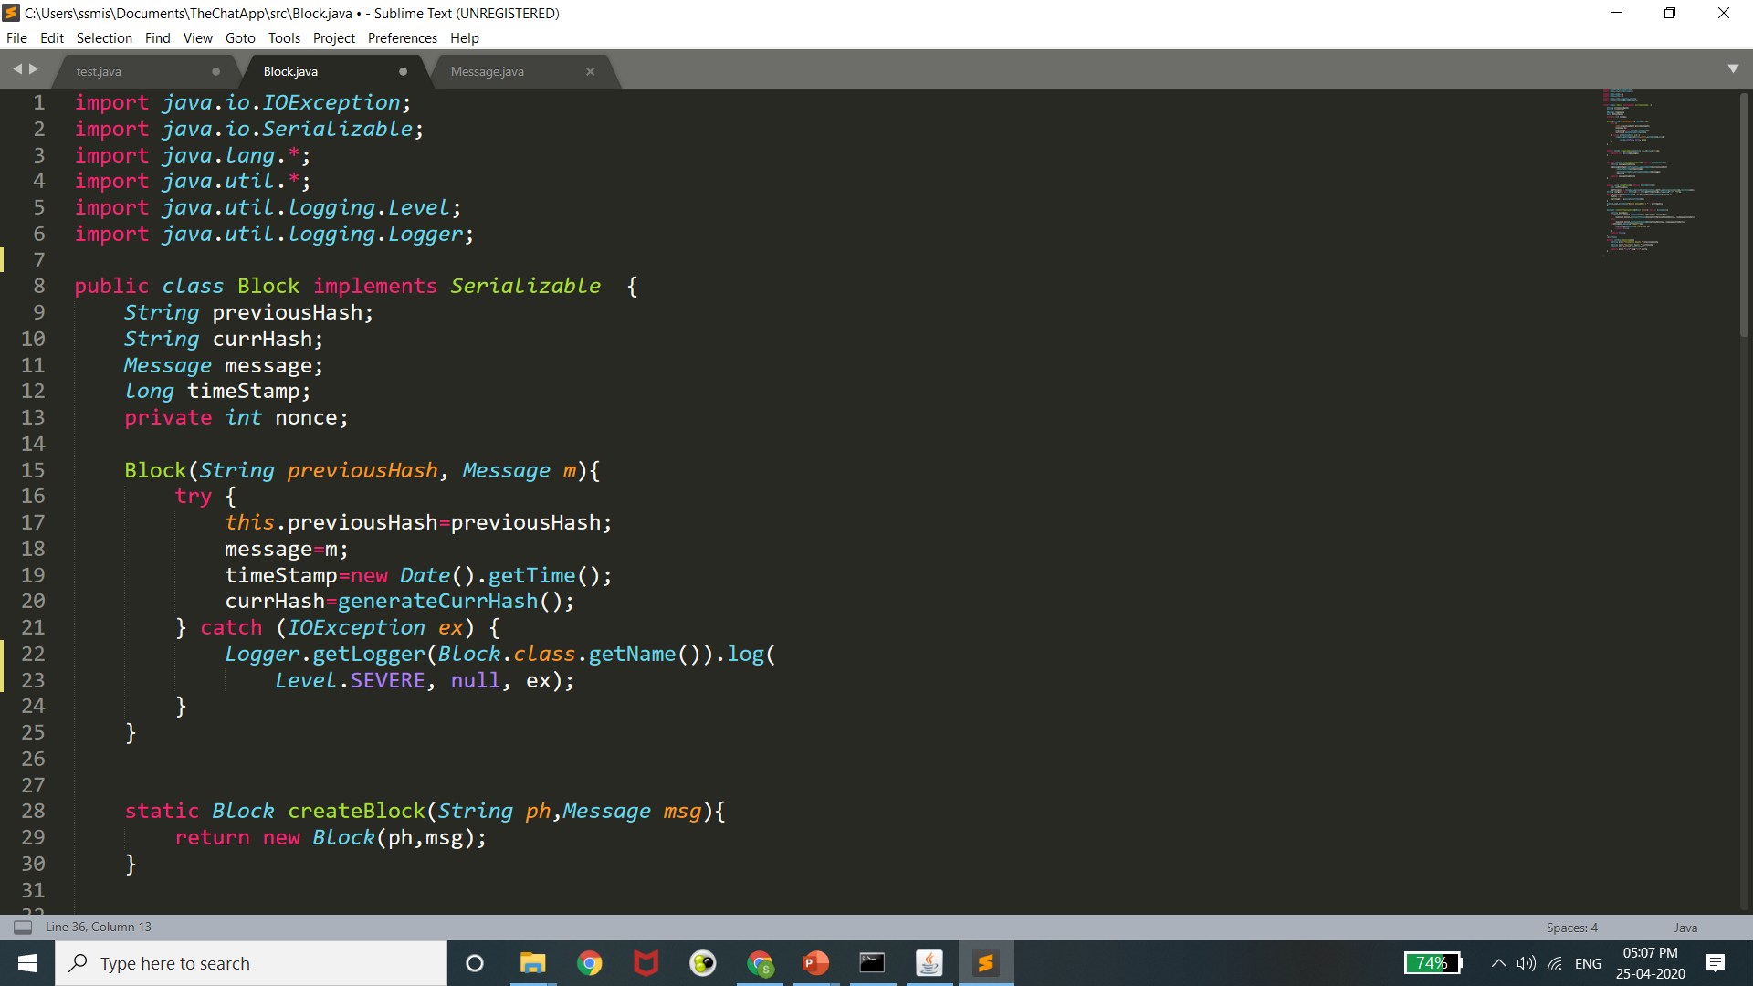
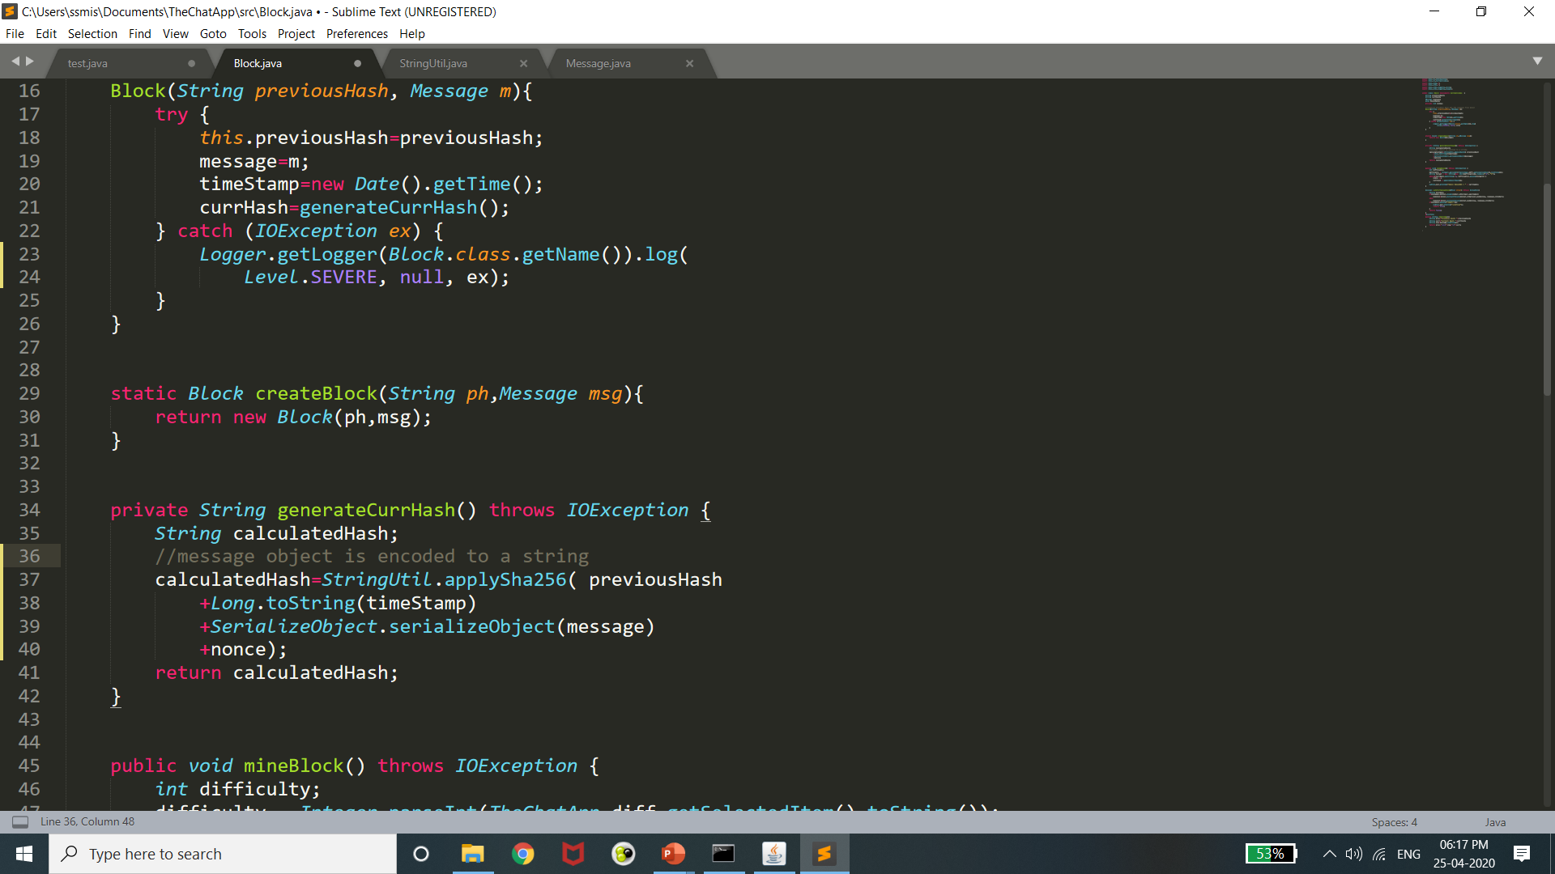
block class
A block stores the previous hash, current hash, a time stamp to give randomness and uniqueness and a nonce (helps in mining a block). Hash is hexadecimal string that is generated using SHA256, the function that is in class StringUtil. The hash is very, very random and is impossible to decode.

Slide 9
Required functions
As part of the project, we were supposed to implement four functions:
createBlock(): Present in Block class, would create an object of class Block using the blockchain’s last hash, called by a Miner. The hash generated is not final. Gets updated when the block is mined.
verifyTransaction(): Present in Block class, would verify whether the sender is a valid user using a zero knowledge proof (more precisely, to verify whether the sender knows his private key or not, without the Miner actually knowing his private key.) Called by a miner just before broadcasting the block to ensure Correctness of all Transactions in the blockchain.
mineBlock(): Present in Block class, would require the proof of work for creating a block. Called by a miner.
viewUser(): Equivalent to our getUser() method. Present in TheChatApp class (GUI class), it would display all the messages received by the current user by browsing through the blockchain (last block to first block using previous hash). If the user is able to decode the message, then he is the intended receiver. Called by the button “view my messages” on GUI.

Slide 10
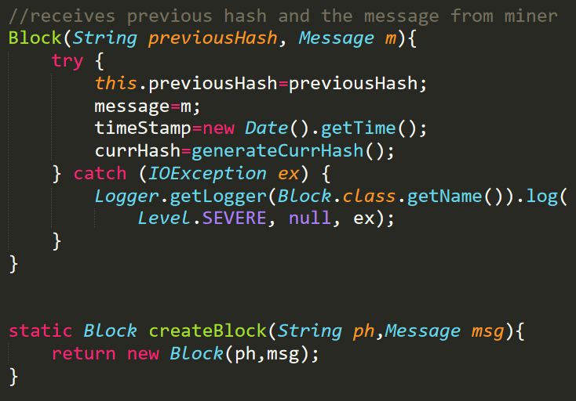
createBlock()
Used by miners in the network to create a block for the blockchain.
We ensure that if the block is the first block (Genesis block) , we assign it a previous hash of 0.
In all other cases, we take the current hash of the last block of the blockchain and provide it as the previous hash for the new block.

Slide 11
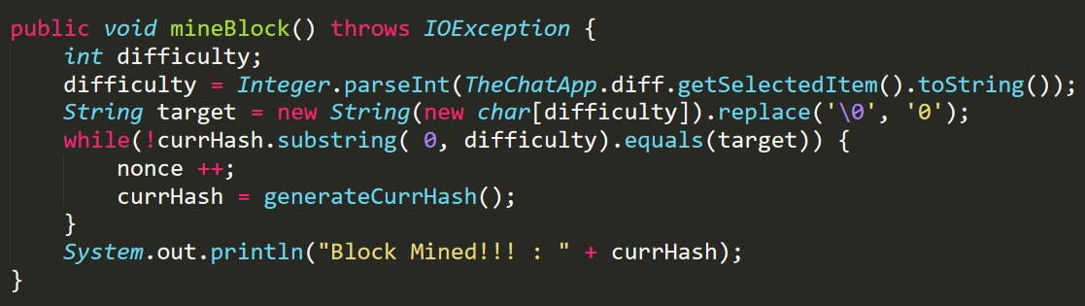
mineBlock()
In case there are multiple miners, we have to ensure that blocks are not repeated. Therefore, we create a proof of work to make sure that every miner spends some computational power before broadcasting a block. This would take time, and hence only that block would be added to the block chain which would be mined first. Once this block is added, the previous hash of new blocks generated would not match with the current hash of last block, and these duplicate blocks will not be added.
For proof of work, we ensure that the first “difficulty” digits of the current hash is 0. A nonce value is constantly updated and added unless we get required hash. For a difficulty of 5, it takes usually 3-4 seconds.

Slide 12
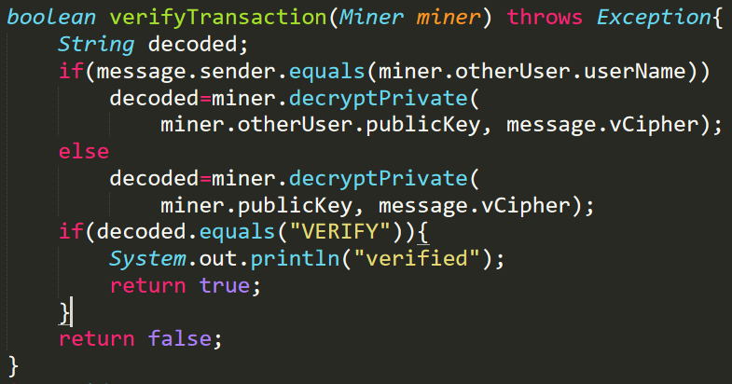
verifyTransaction()
A transaction (message in our application) must be verified before it is added to the block by a miner. If we can ensure that, then we can ensure the ‘Integrity’ of all the transactions in our blockchain.
In our application, Each user (node) in the blockchain possesses a pair of keys that are generated using the built-in R.S.A. KeyPairGenerator class in Java. One key out of the pair becomes the user’s Public key (PU) and the other one becomes his/her Private key (PR). This key pair possess certain Cryptographic properties (listed below) which make it infeasible to derive one using the other.
R.S.A Algorithm to generate the Key pair (PU,PR)
Select two large distinct primes p and q using any P.R.N.G or T.R.N.G.
Calculate n as product of p and q.
Calculate totient ϕ(n) as the product of (p-1) and (q-1) [Since both are primes]
Select an integer e such that e lies in (1, ϕ(n)) and gcd(ϕ(n),e)=1 i.e. e and ϕ(n) are coprime.
Calculate d using Extended Euclidian's algorithm as the modular inverse of e under ϕ(n) i.e. d.e mod ϕ(n) ≡1.
PU = {e,n}
PR = {d,n}
Mathematical Security of R.S.A
Factorization problem – Very difficult to compute p and q based on the value of n.
Modular root extraction – Very difficult to compute d even if we know n, e, cipher text.

Slide 13
Zero-knowledge proof
Lets suppose the two users involved in the transaction are Alice and Bob. Both have their corresponding R.S.A Key pairs as {PU(A),PR(A)} and {PU(B),PR(B)}. Let Alice be the sender and Bob as the receiver.
Now, Alice holds sensitive data PR(A) ,which should never be disclosed for security reasons but at the same time we want Bob to realize that Alice has PR(A). Hence, PR(A) forms the pivot of our zero knowledge proof.
In our application, Each message (transaction) has an additional parameter called vCipher that stores the string “VERIFY”.
It is assumed that both the users know that vCipher stores “VERIFY”.
Alice encrypts ( using R.S.A ) the message to be sent to Bob using PU(B). Let this encrypted message be cipher 1. This encryption ensures Confidentiality as this can be decrypted by only Bob using PR(B) (known only to him). But the issue arises with the Authentication aspect of the sender (Alice). Since, PU(B) is public information, even an attacker can send a message to Bob.
This is where we use our concept of Zero Knowledge Proof to verify the Authenticity of the Sender of the message (Alice in this case).
Now, Alice uses her sensitive data [PR(A)] on the string vCipher as a R.S.A key for encryption. Let this encrypted vCipher be cipher 2. The message is now sent to Bob (receiver) as cipher 1 and cipher 2.
Bob receives the message (explained above ,using cipher 1) but is not sure if the Sender (Alice) is a valid user.
Since Bob has access to the Public keys of all the users of the blockchain, he searches ( brute force) if, by ‘Decrypting’ cipher 2 using any of the Public keys, he gets a string “VERIFY” (Acts as a validation string). If Yes, then Bob can not only validate the Sender but also know his/her identity (using Public key). If No, then Bob knows that the message should be discarded as the Sender is not a valid user in the blockchain. In this case, since Alice is a valid user, Bob verifies it using PU(A).
Hence, without ever disclosing her(Alice) sensitive data [PR(A)] to Bob, Bob was able to ensure that she(Alice) knows it. This works because Alice could never be validated as an Authentic sender unless Bob(receiver) can confirms it.

Slide 14
Proof of the reasoning of z.k.p
vCipher is “VERIFY”, Sensitive data(x) is PR(A), n is the n contained in PU(A),PR(A)
At Alice’s end, cipher2 = (vCipher^{x}) mod n –> Encryption
At Bob’s end, text =((cipher2)^{PU(A)} ) mod n -> Decryption
= replacing the value of cipher 2 from encryption
= (vCipher^{x.PU(A)})mod n
= Using Chinese Remainder Theorem, one can show that the above eqn. is equal to,
(vCipher^{x.PU(A)}) mod p and (vCipher^{x.PU(A)}) mod q
= we have already proved that x and PU(A) are modular inverses of each other.
Hence, we get text as vCipher , whose value “VERIFY” is known to the receiver (Bob)

Slide 15
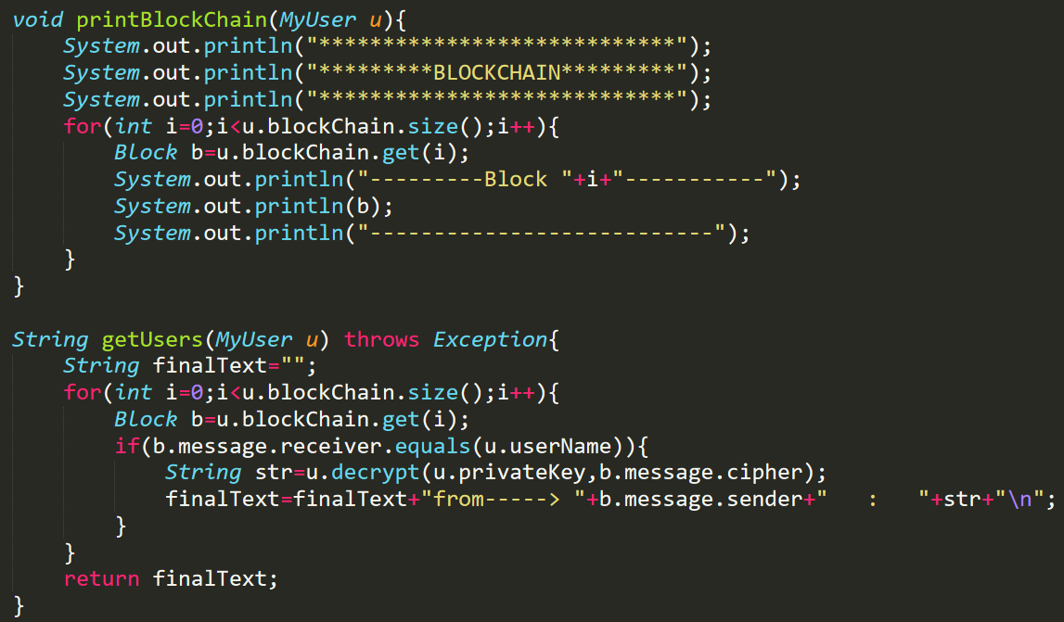
viewUser() / getUsers()
It would display the contents of the block chain, if the person accessing the message is the intended receiver.
We also use a function to display the blockchain on terminal.
It basically starts from the last block of the blockchain and then traverses using the previous hash and checks the messages in the blocks for the corresponding messages of the user.

Slide 16
conclusion
We achieve the following goals through our application :
Decentralized Chat Application
Resistance to Brute Force, Timing and other Cryptanalytic Attacks.
Distributed Ledger with all nodes.
Mathematical Security.
C.I.A triad (Confidentiality, Integrity and Availability)
Consensus Protocol among the nodes.
Thank You!

